Slide 1
Distributed System 1. Characterization Principles
Introduction by hermawan

Slide 2
Goal of Study
Student has a knowledge from distributed technology concept in the information system field
Student has skill to design distributed system in the information system
Student has basic programming in Webservice

Slide 3
Literature
George Coulouris, DISTRIBUTED SYSTEMS Concepts and Design, fifth edition, Cambridge University
Andrew S. Tanenbaum, Principles and Paradigm, third edition, Amsterdam University

Slide 4
Lesson Subject
Introduction : Characterization to distributed systems
Architectural Style
Inter-process Communication and Networking
Messaging Process
Application Layering for distributed systems
Web-Service Programming
BPMS Service Orchestration
Distributed File System of Big Data (Hadoop-Spark)
Distributed Database, Replication and Fragmentation
Mobile Apps Distribution

Slide 5
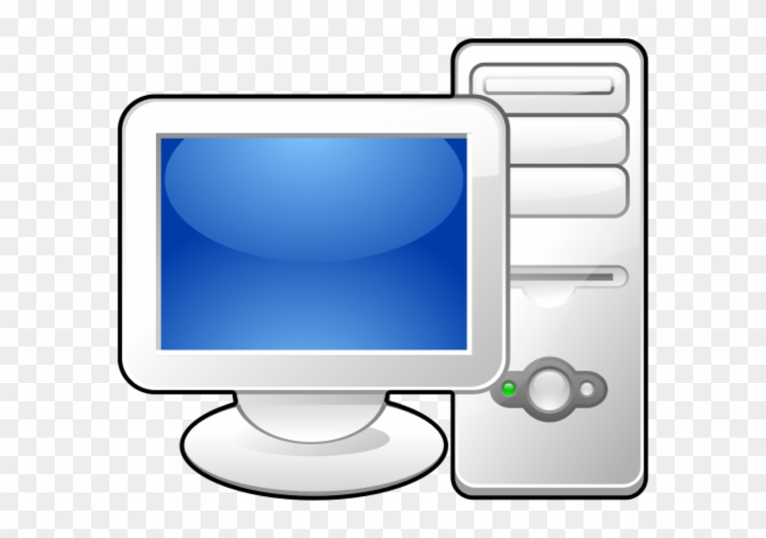
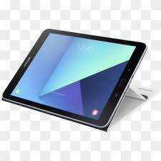
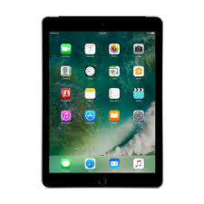
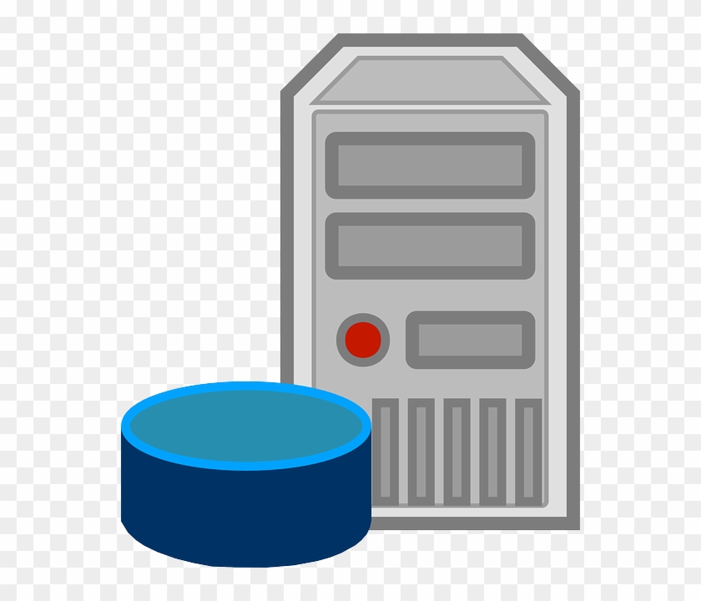
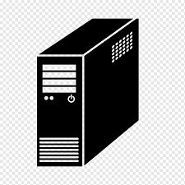
Characterization to distributed systems Centralized Vs Distributed
Centralized
OR
Distributed

Slide 6
Characterization to distributed systems 3-Tier Distributed System
We define a distributed system as one in which hardware or software components located at networked computers communicate and coordinate their actions only by passing messages/Services.
Presentation
Logic
Data

Slide 7
Characterization to distributed systems N-Tier Distributed System

Slide 8
Characterization to distributed systems Requirements
Concurrency: In a network of computers, concurrent program execution is the norm.
No global clock: When programs need to cooperate they coordinate their actions by exchanging messages.
Independent failures: All computer systems can fail, and it is the responsibility of system designers to plan for the consequences of possible failures.

Slide 9
Characterization to distributed systems Challenges
1. Heterogeneity:
networks;
computer hardware;
operating systems;
programming languages;
implementations by different developers.

Slide 10
Characterization to distributed systems Challenges
2. Openness:
Open systems are characterized by the fact that their key interfaces are published.
Open distributed systems are based on the provision of a uniform communication mechanism and published interfaces for access to shared resources.
Open distributed systems can be constructed from heterogeneous hardware and software, possibly from different vendors.

Slide 11
Characterization to distributed systems Challenges
3. Security, Many of the information resources that are made available and maintained in distributed systems have a high intrinsic value to their users.
Sessions
Enscription

Slide 12
Characterization to distributed systems Challenges
4. Scalability:
Distributed systems operate effectively and efficiently at many different scales, ranging from a small intranet to the Internet.

Slide 13
Characterization to distributed systems Challenges
5. Failure handling:
Computer systems sometimes fail. When faults occur in hardware or software, programs How to solve it,

Slide 14
Characterization to distributed systems Challenges
6. Concurrency: Both services and applications provide resources that can be shared by clients in a distributed system.

Slide 15
Characterization to distributed systems Challenges
7. Transparency:
Transparency is defined as the concealment from the user and the application programmer of the separation of components in a distributed system, so that the system is perceived as a whole rather than as a collection of independent components

Slide 16
Characterization to distributed systems Challenges
8. Quality of service:
The main nonfunctional properties of systems that affect the quality of the service experienced by clients and users are reliability, security and performance. Adaptability to meet changing system configurations and resource availability.

